Slide 1

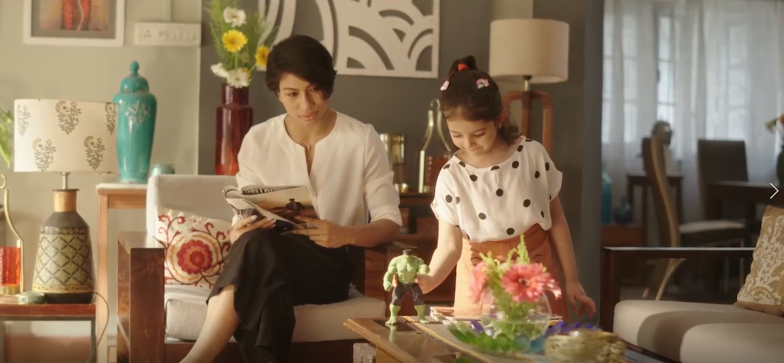
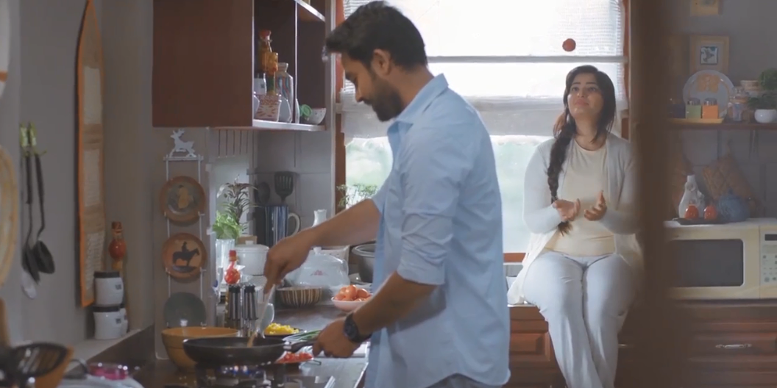
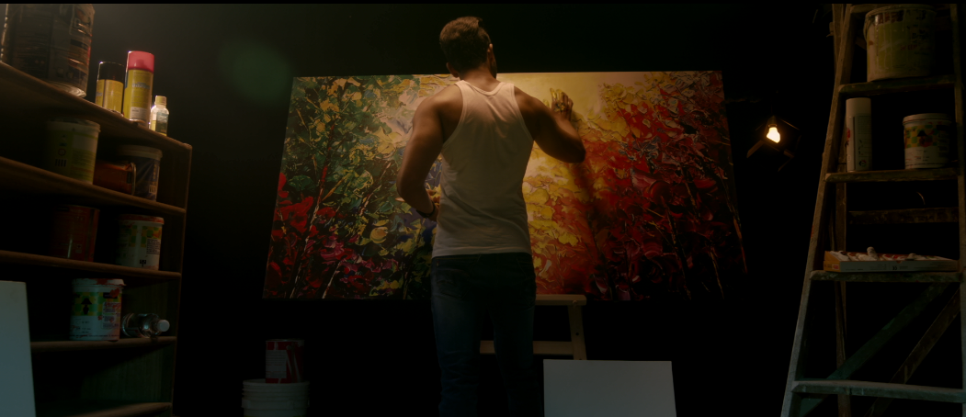
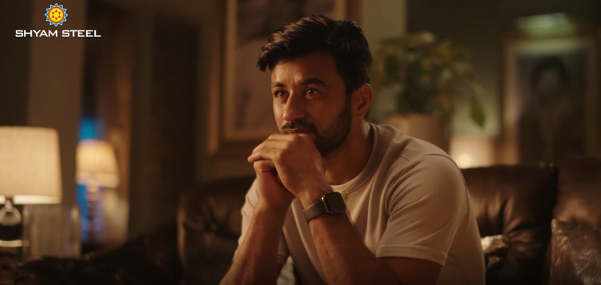
We are
Bizsun Creative.
A One-Stop Audio Visual Production House

Slide 2
ABOUT US
We are an audio-visual production house founded by experienced industry professionals and young creative-technical enthusiasts.
We nurture the best and experienced professionals in every department to cater to your need and offer you the finest output that are original as well as unique.
Our aim is to grow as a company along with you by providing you the best of our production services.
Quality is our identity, commitment is our strength..

Slide 3
WHAT
WE DO
Photography
We click photos for:
Lifestyle shoots
Fashion shoots
Product shoots
E-commerce shoot
Film Production
We produce films as:
Television commercials
Digital films
Corporate films
Factory shoots

Slide 4
OUR IN-HOUSE FACILITIES
Complete Production
Executive Producer
Film Directors
Illustrator
Videographer
Still Photographer
Studio Setup with 4K cameras

Slide 5
HOW WE DO IT
Initial brief
Ideation/ Scripting
Storyboard
Execution

Slide 6
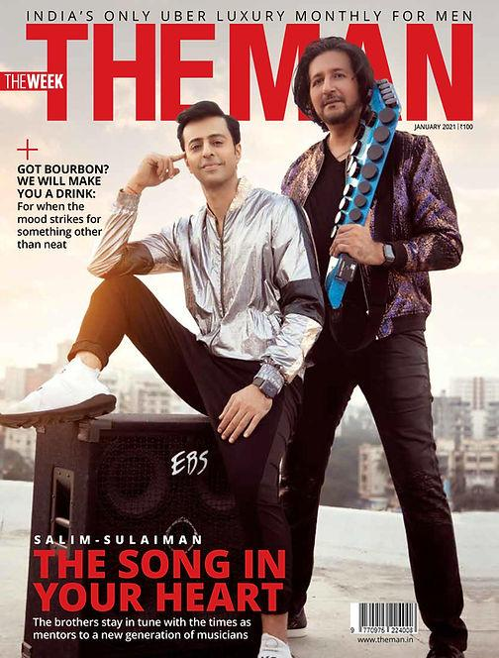
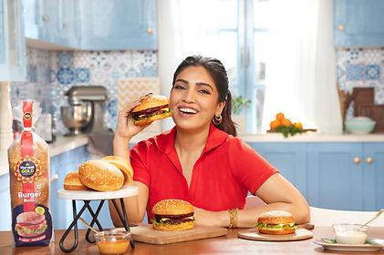
PHOTOGRAPHY
By Sehrish Qureshi

Slide 7

PHOTOGRAPHY
By Sehrish Qureshi

Slide 8
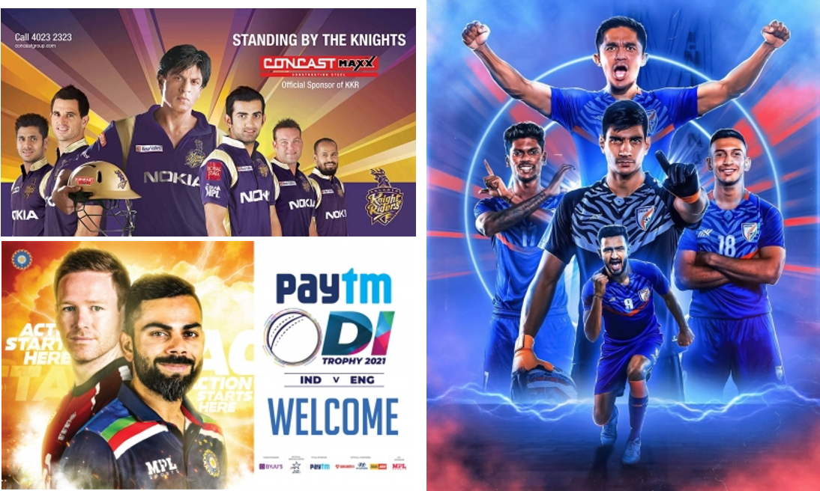
PHOTOGRAPHY

Slide 9

PHOTOGRAPHY

Slide 10
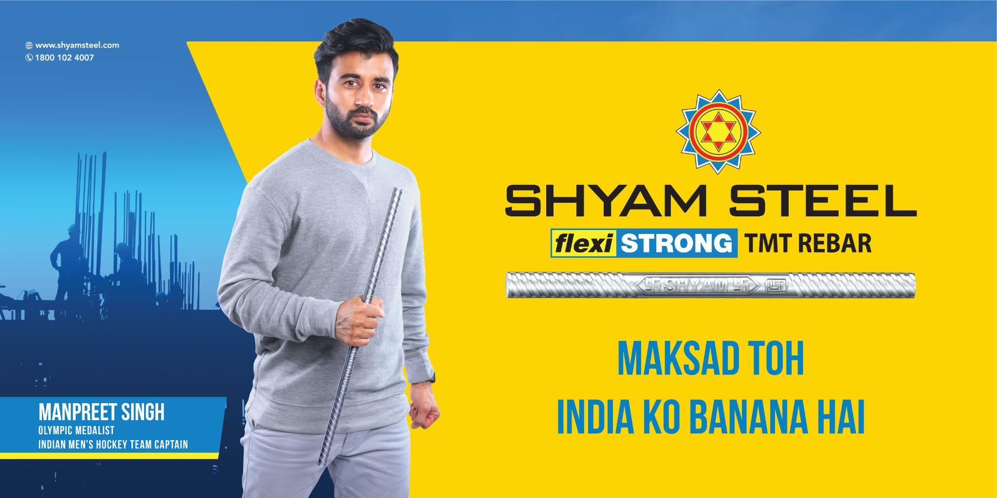
PHOTOGRAPHY

Slide 11

PHOTOGRAPHY

Slide 12



PHOTOGRAPHY

Slide 13




PHOTOGRAPHY

Slide 14



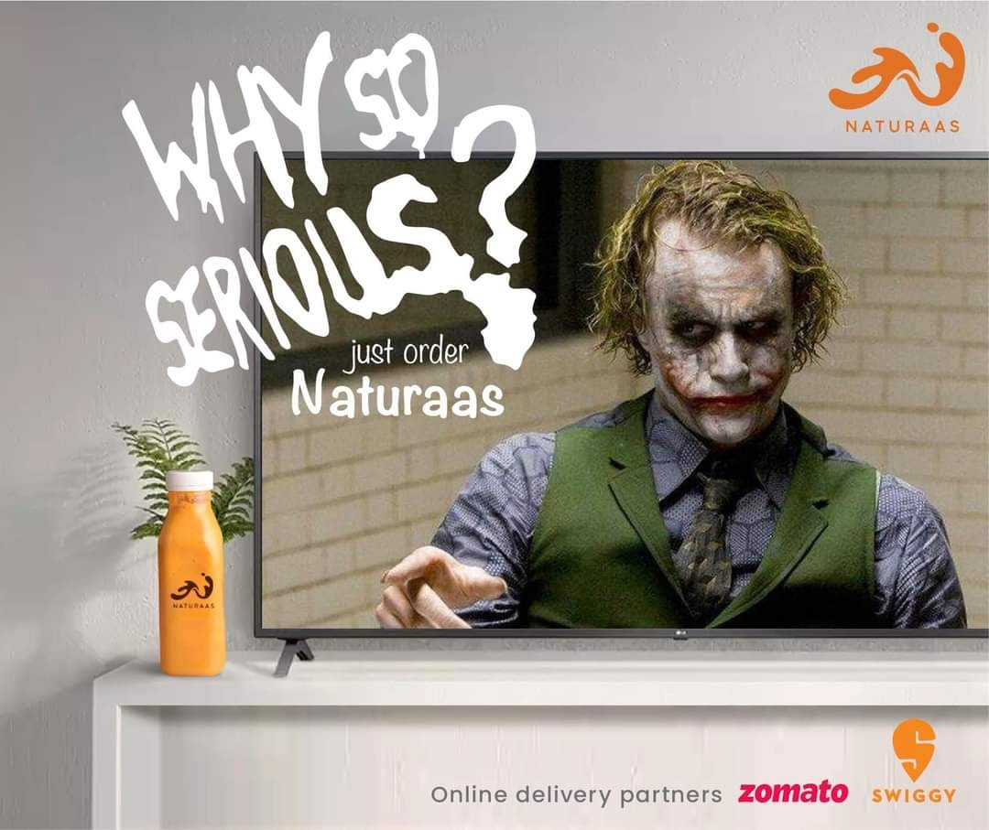


PHOTOGRAPHY

Slide 15
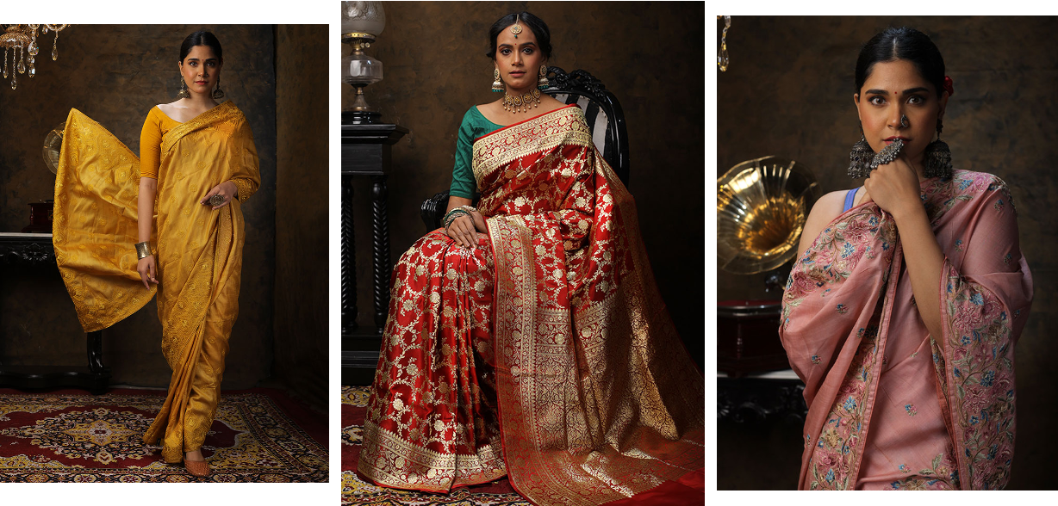

PHOTOGRAPHY

Slide 16





3D ART WORKS

Slide 17

BRAND FILMS

Slide 18
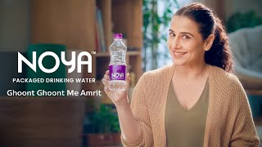
BRAND FILMS

Slide 19
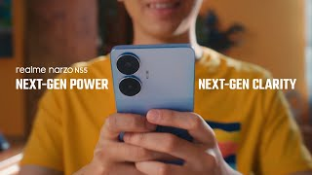
BRAND FILMS

Slide 20
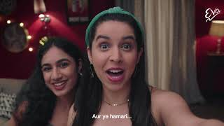
BRAND FILMS

Slide 21

BRAND FILMS

Slide 22
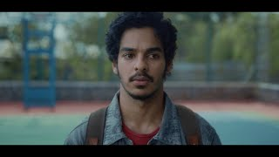
BRAND FILMS

Slide 23

BRAND FILMS

Slide 24

BRAND FILMS

Slide 25
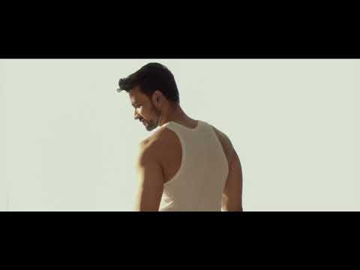
BRAND FILMS

Slide 26
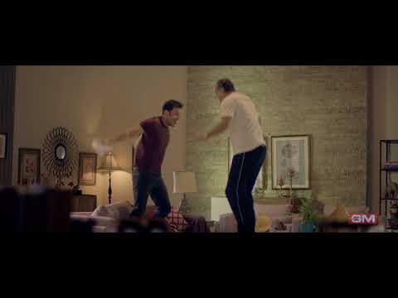
BRAND FILMS
By
Sehrish Qureshi

Slide 27
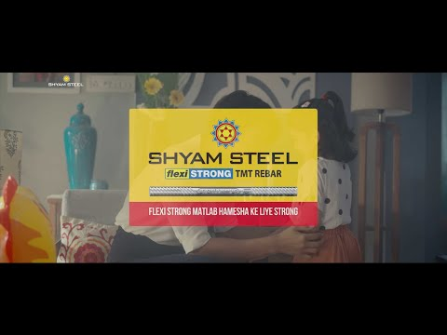
BRAND FILMS

Slide 28
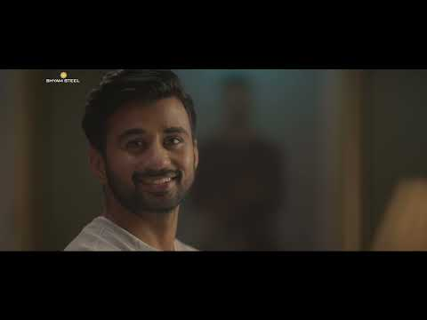
BRAND FILMS

Slide 29
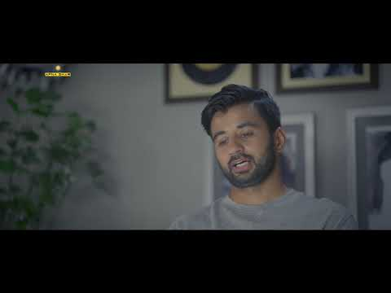
BRAND FILMS

Slide 30

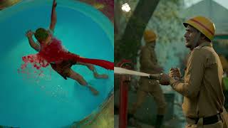
BRAND FILMS

Slide 31
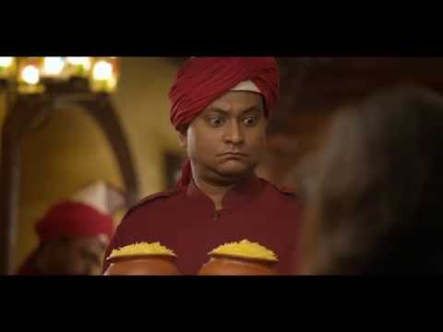
BRAND FILMS

Slide 32
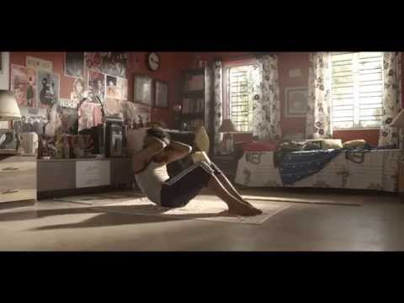
BRAND FILMS

Slide 33

3D ANIMATION

Slide 34

3D ANIMATION

Slide 35

FACTORY SHOOT

Slide 36
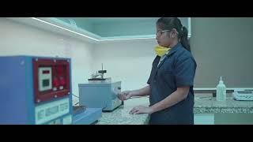
FACTORY SHOOT

Slide 37
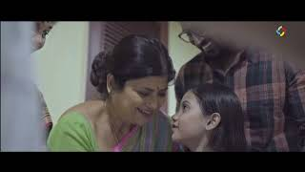
CORPORATE SHOOT

Slide 38














NOTABLE CLIENTS & AGENCIES

Slide 39
CLIENT REVIEWS
“The team pulled the shoot off brilliantly in the stipulated time. Kudos!”
Brand Head
“They always deliver more than what they commit. The value addition is commendable”
Creative Head

Slide 40
THANKS!
Want to have a quick chat?
info@bizsoncreative.com +91 70441 78863 www.bizsoncreative.com
Mumbai Delhi Kolkata

